Slide 1



Amadeus team, Nice France

Slide 2
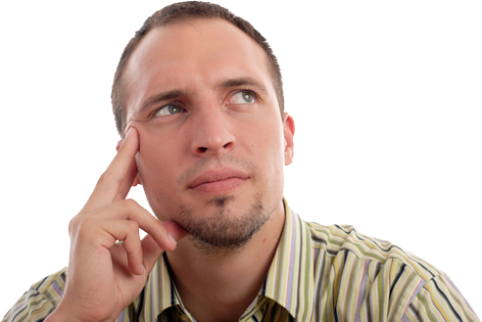
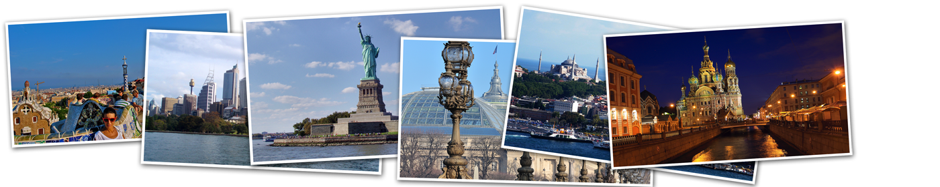
You’re looking for vacations but you have no idea of where to go or what to do ?
If only a tool was able to understand what I like and what I did in the past to suggest me the best options…

Slide 3

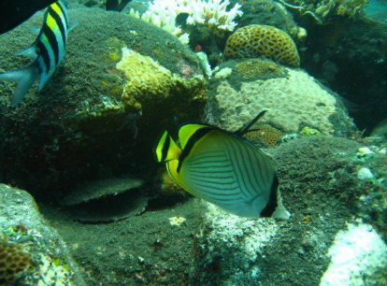
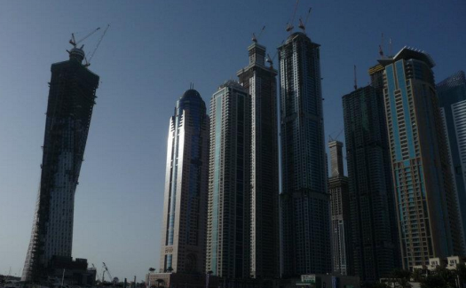

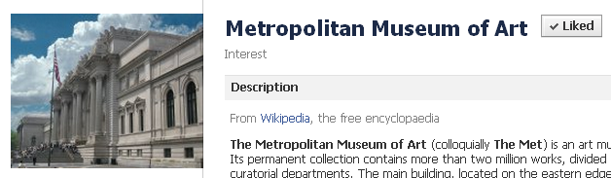
…looking at the pages and photos I liked on Facebook, at my albums, my posts, my check-ins to build for me the perfect personalized tour

Slide 4
Our idea
getinspired is a travel inspiration product running on web browsers and tablets which:
mines the traveler’s Facebook data to suggest relevant destinations/activities/events
Builds automatically a personalized tour
FACEBOOK MINING
TABLET
INSPIRATION
SOCIAL
MOBILE
PERSONALIZATION

Slide 5



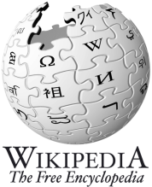







Wrap-up
Mine
Infer
Aggregate
Pictures
Themes
Flights
Posts
Destinations
Hotels
Likes
Events
Check-ins
Activities
Events
POIs
… into a personalized tour

Slide 6
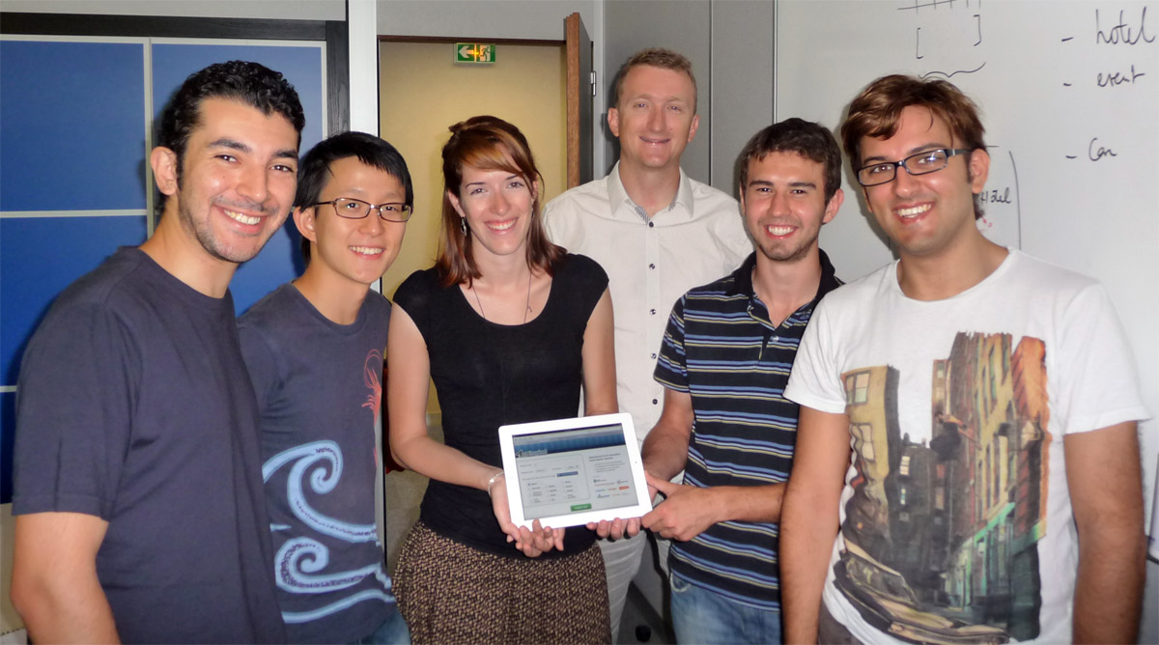
The team
Proudly hacked by 6 Amadeus engineers working in Sophia Antipolis, France
Omar, Xindong, Émeline, Pierre-Étienne, Bruno and Domenico

Slide 7
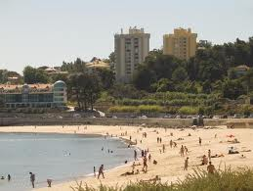
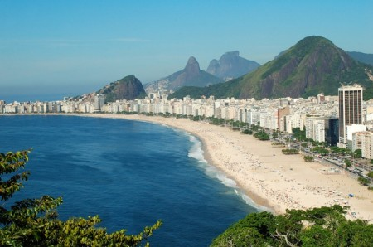




Some examples
Application finds that this picture looks like Copacabana’s beach
Application deducts that you may be interested by Rio de Janeiro
You liked this picture (Lisbon’s beach)
Application finds that this page is related to Museum and History so you could be interested by the theme “history”
Application will find activities and events related to the history theme
You liked the Facebook page of the “Metropolitan Museum New York”
Application deducts that you have been to New York City, which is associated to the art, shopping, city and history themes
Application will suggest cities having a similar profile (e.g. London or Boston)

Slide 8

f
Can be extracted “as is” from the Facebook Graph API (Xindong?)
The user’s Facebook account
b
Can be extracted using Bruno’s destination extraction tool
Likes (Facebook Pages)
Events (Facebook Events)
Check-ins (Facebook Check-ins)
e
Can be extracted using Emeline’s destination extraction tool
f
f
f
Destinations (Page’s location data if any)
Destinations (Event’s location data if any)
Destinations (Check-in’s location data)
b
b
b
Destinations (Bruno’s engine)
Destinations (Bruno’s engine)
Destinations (Bruno’s engine)
Albums (Facebook Albums)
Photos (Facebook Photos)
Statuses (Facebook Status)
f
Destinations (Photo’s location data if any)
f
Destinations (Album’s location data if any)
Destinations (Bruno’s engine applied to legend)
b
Destinations (Bruno’s engine applied to legend)
b
Destinations (Bruno’s engine)
b
Destinations (Emeline’s picture’s recognition)
e
Next phases?
The user’s friends Facebook accounts
Liked Photos (Facebook Photos)
Comments (Facebook Comments)
Bruno’s Destinations to Activities converter
Destinations (Photo’s location data if any)
f
b
Pierre-Etienne’s Destinations to Destinations Converter (climate)
Destinations (Bruno’s engine applied to legend)
b
Destinations (Bruno’s engine)
Destinations (Emeline’s picture’s recognition)
e
Recommended Destinations

